Slide 1
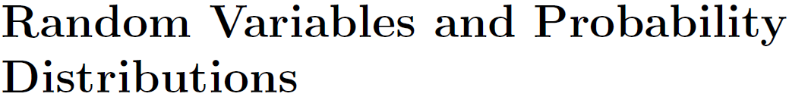

Slide 2
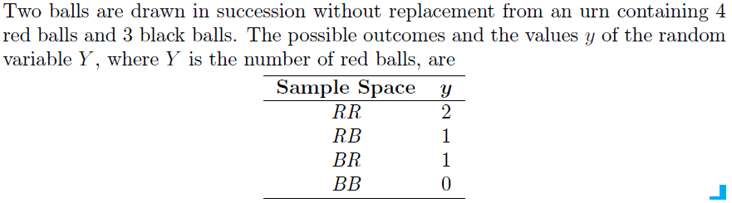

Slide 3
Sample Space | Y | P(Y)
RR | 2 | 2/7
RB | 1 | (4/7)(3/6)=2/7
BR | 1 | (3/7)(4/6)=2/7
BB | 0 | (3/7)(2/6)=1/7

Slide 4


Slide 5
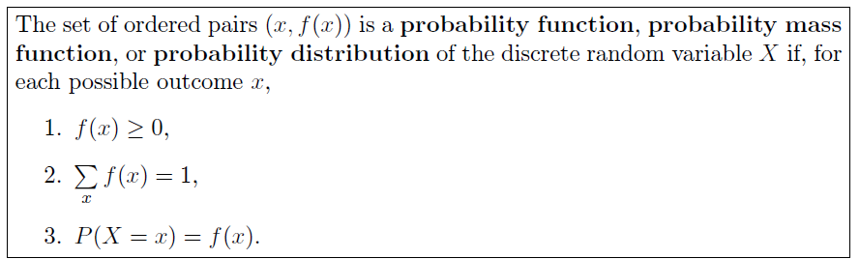

Slide 6
Probability Distribution Function
Sample Space | Y | P(Y)
RR | 2 | 2/7
RB | 1 | (4/7)(3/6)=2/7
BR | 1 | (3/7)(4/6)=2/7
BB | 0 | (3/7)(2/6)=1/7
Y | 0 | 1 | 2
P(Y=y) | 1/7 | 2/7+2/7=4/7 | 2/7

Slide 7
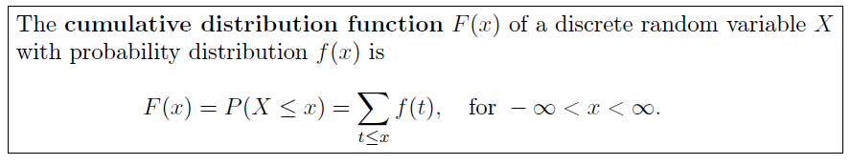

Slide 8
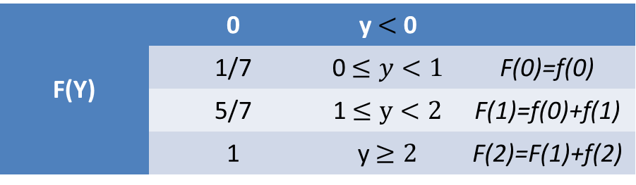
Cumulative Distribution Function (CDF)
Y | 0 | 1 | 2
P(Y=y) | 1/7 | 2/7+2/7=4/7 | 2/7
F(Y) | 0 | y $<$ 0
 | 1/7 | 0$≤y<1$ | F(0)=f(0)
 | 5/7 | 1$≤y<2$ | F(1)=f(0)+f(1)
 | 1 | y$≥2$ | F(2)=F(1)+f(2)

Slide 9
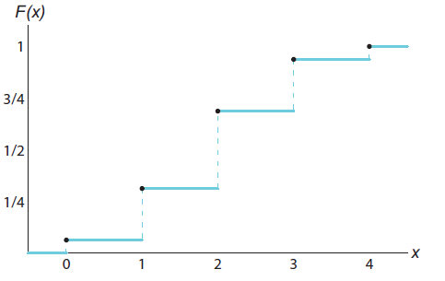
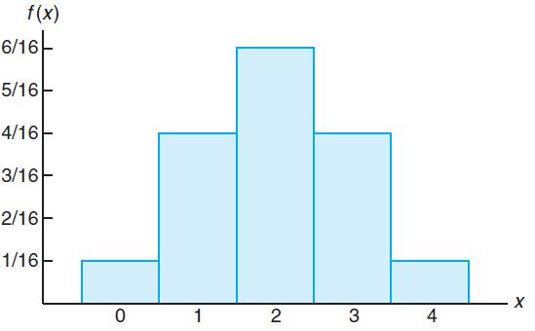
Graphical Representation of PDF and CDF
PFD is represented by using Histrogram with sample points along x axis and probability along y axis | CDF is represented by using step graph with sample points along x axis and cumulative probability along y axis

Slide 10
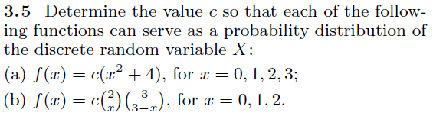
(c) Find PMF and CDF for the function (d) Represent PMF and CDF graphically

Slide 11
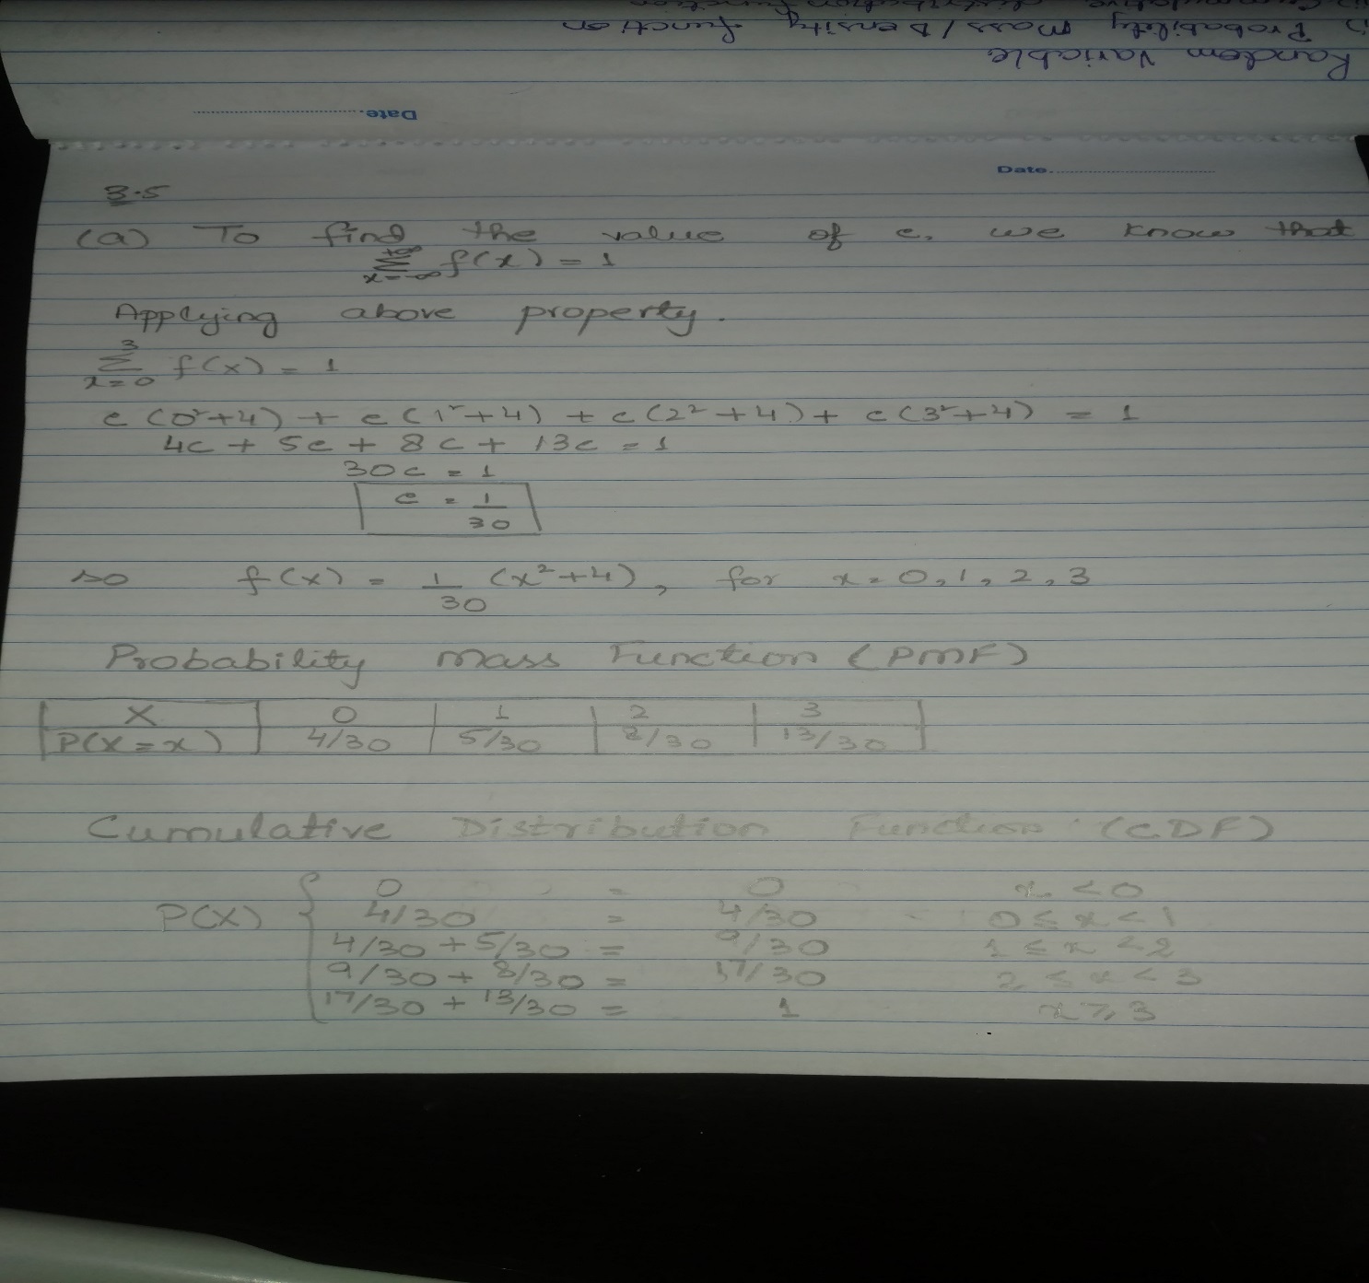

Slide 12
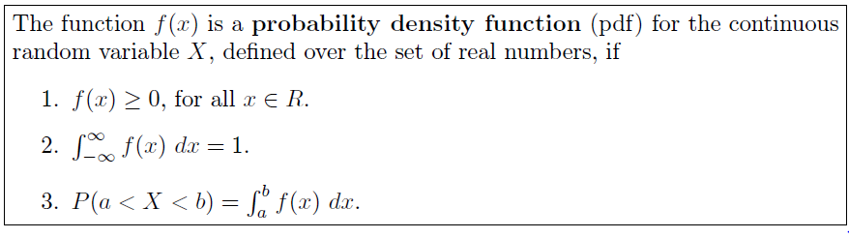

Slide 13
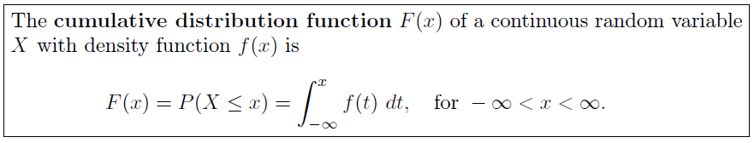

Slide 14
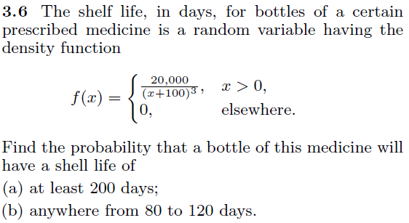
(c) Prove that the function is PDF.
(d) Find CDF for the function.

Slide 15
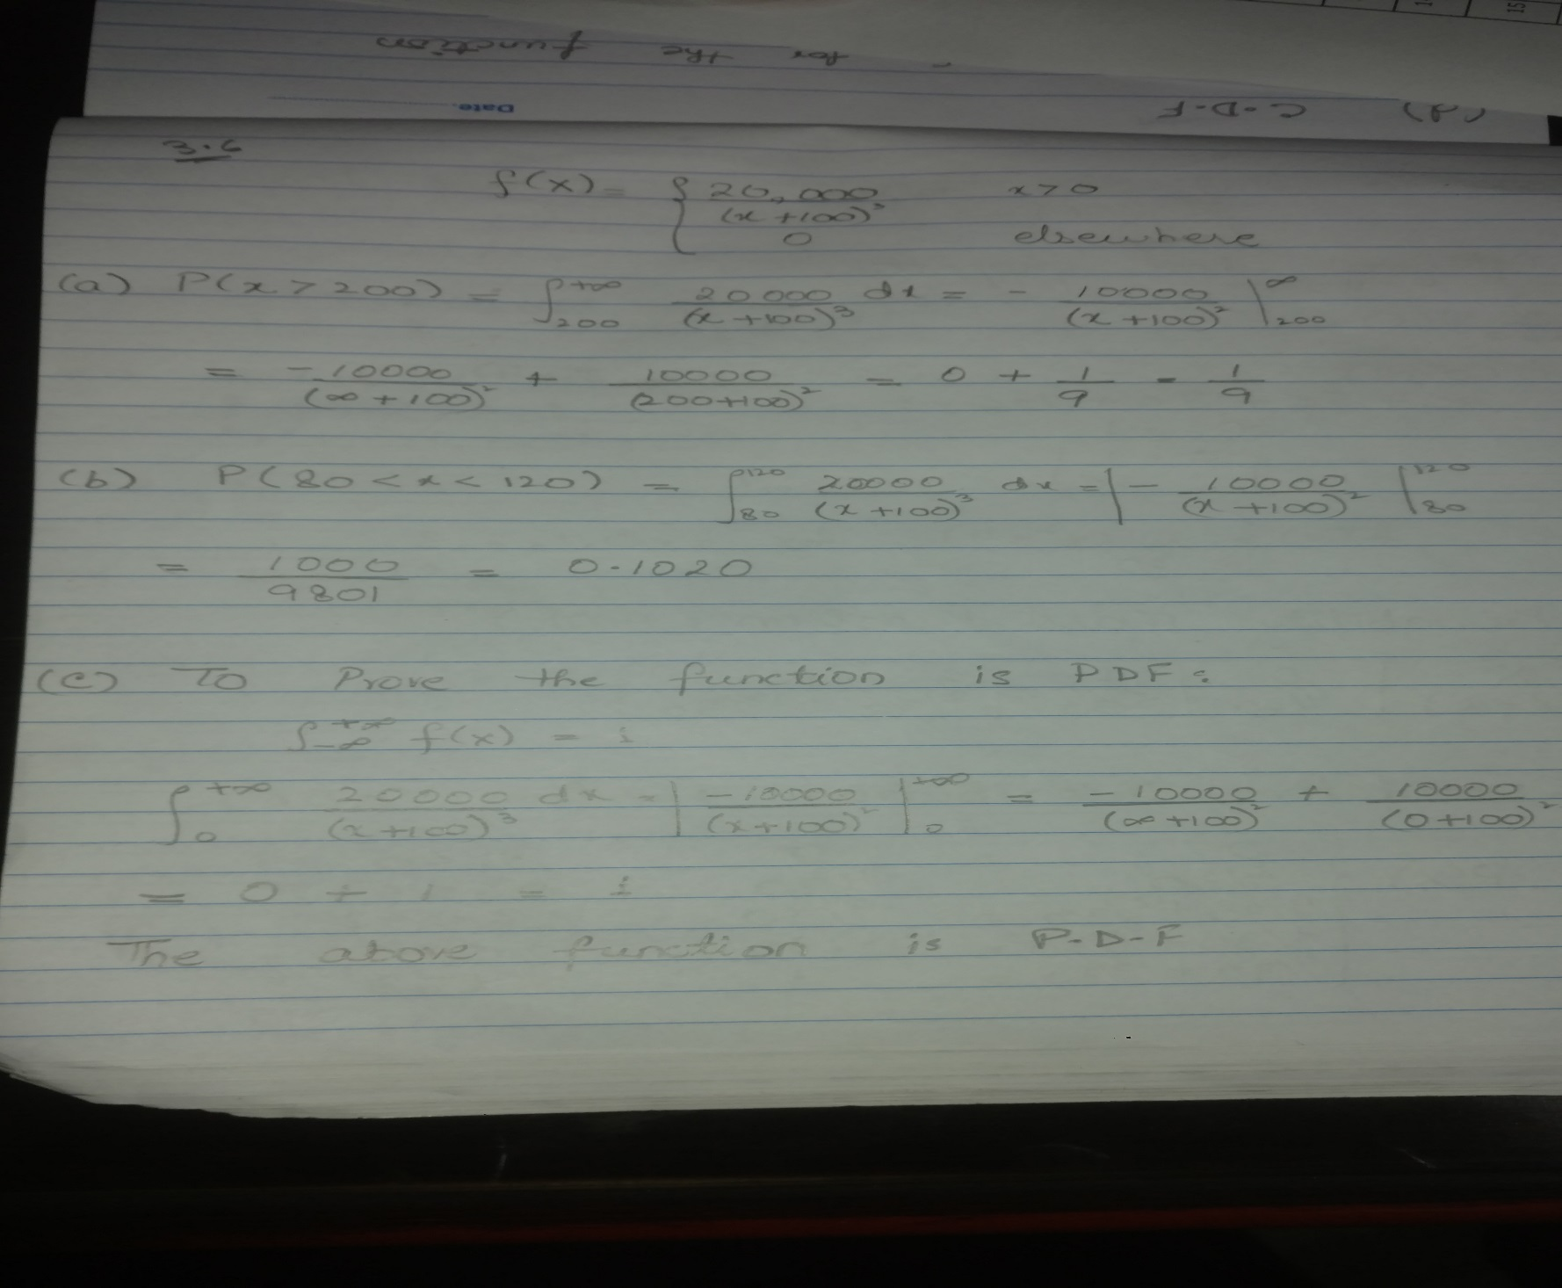

Slide 16
